Slide 1
Modeling Student Understanding of Period, Frequency, and Angular Frequency
Nicholas T. Young
Andrew F. Heckler
The Ohio State University
Notes:
Good afternoon, I’m Nicholas Young and I’m be talking about modeling student understanding of period, frequency, and angular frequency. For those who would like to follow along their phones or like a copy of the presentation, feel free to scan the code on the screen.

Slide 2
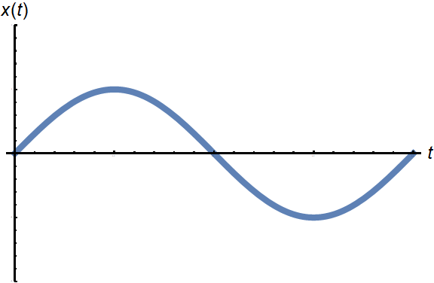
Introduction
Period: T
Wan et al (2016)
Frequency: f
Angular Frequency: ω
Oscillations
Ambrose (2007)
Tongnopparat et al (2014)
Waves
Kryjevskaia et al (2012)
Wittman (2003)
Rotations
Rimoldini and Singh (2005)
Notes:
Period, frequency, and angular frequency are three commonly used quantities and concepts in physics, appearing in many contexts such as oscillations, waves, rotations, AC circuits, motors, and generators. Therefore, it is important for students to be proficient in working with these three quantities in various graphical and mathematical representations. Previous work has tended to focus on applications of these quantities rather than studying student understanding of them. We’ve explored student difficulties with these three quantities in our previous work and here, we wish to explore the structure of that knowledge.

Slide 3
Research Goal
Goal: Search for possible hierarchies in student knowledge regarding finding the period, frequency, and angular frequency from various representations
(Hierarchical Relation)
Skill A Skill B
Skill A
Skill B
Notes:
Specifically, we wish to determine if any hierarchies exist between skills needed to determine the period, frequency, and angular frequency from various representations. By hierarchy, I mean that if a hierarchy existed between two skills, let’s call them skill A and skill B, with skill A implying skill B, then if a student knows how to do skill A, they would also know how to do skill B. Knowing if such relationships exist is essential for developing trainings and interventions on these topics.

Slide 4
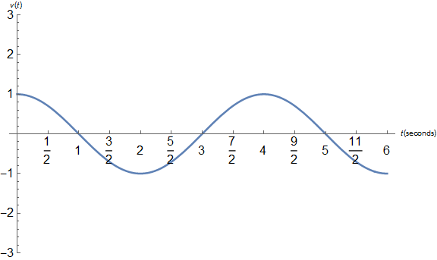
Reasons for Hierarchy
Graphical Representation
Mathematical Representation
$x\left(t\right)=2cos(\frac{π}{3}t+\frac{π}{4})$
To find angular frequency:
Find period
Use $ω=\frac{2π}{T}$
To find period:
Find angular frequency
Use $ω=\frac{2π}{T}$
Notes:
We expect there to be some hierarchical structure due to the nature of which parameters can be directly found from a given representation. In general, to find the angular frequency from a graphical representation, a student would first find the period and then use omega equals 2 pi over T to get the angular frequency. Similarly, to get the period from a mathematical representation, the student would first need to identify the angular frequency and then apply omega equals 2 pi over T to get the period.

Slide 5
Methods
Pilot Studies/ Interviews
Spring 2014
Introductory, algebra-based physics students
N=590
Online, 30-item multiple choice test
Student Difficulties/ Question Refinement
Mock Recitation Sessions
Online Essential Skills Training
Spring 2017
Hierarchies
Notes:
This experiment is the fourth stage of a larger investigation into student understanding of period, frequency, and angular frequency. To collect data for this experiment, we administered a 30-item online multiple choice test to students in a large-enrollment, introductory, algebra-based physics course, typically taken by life science and pre-med students.

Slide 6
Sample Questions
What period is depicted in the following graph?
The equation
$x\left(t\right)=7cos(\frac{2π}{5}t+3)$ describes the motion of a mass on a spring. What is the frequency of this motion?
Graphical Question
Equation Question
A harmonic oscillator has a frequency of ¼ Hz. What are the angular frequency and the period?
Calculation Question
Notes:
On the test, we use three styles of questions, graphical questions, equation questions, and pure calculation questions. These questions styles were then used to form nine skills. The first two skills come directly from a specific representation: determining the period from a graphical representation and determining the angular frequency from an equational representation. The next four skills are found indirectly from a representation: determining the frequency or angular frequency from a graphical representation and determining the period or frequency from an equational representation. The final three skills are the mathematical relationships between the three parameters (T=1/f, etc), which are tested by the calculation questions.

Slide 7
Mastery
 |  | Find f from Graph
 |  | Not mastered | Mastered
Find T from Graph | Not mastered | 163 | 13
 | Mastered | 203 | 211
Finding f from graph Finding T from graph
 |  | T=1/f
 |  | Not mastered | Mastered
ω=2π/T | Not mastered | 116 | 189
 | Mastered | 48 | 237
Applying ω=2π/T Applying T=1/f
Notes:
We then found each student’s score on each of the nine types of questions utilizing a single skill. If the student answered at least 75% of the questions correctly, the student was said to have mastered the skill. We then created contingency tables for all possible pairs of skills to look for hierarchies. These examples suggest that knowing how to find the frequency from a graphical representation implies knowing how to find the period from a graphical representation and knowing how to relate period and angular frequency implies knowing how to relate period and frequency.

Slide 8
Initial Results
Find f from
$x\left(t\right)=\cos\left(2πft\right)$ (17%)
Find T from
$x\left(t\right)=cos⁡(\frac{2π}{T}t)$ (23%)
Find ω or f from $ω=2πf$ (28%)
Find ω using
$x\left(t\right)=cos⁡(ωt)$ (33%)
Find ω from graph (24%)
Find T or ω using $ω=\frac{2π}{T}$ (48%)
Find f from graph (38%)
Find T from graph (70%)
Find T or f using $T=\frac{1}{f}$ (72%)
No skills (5%)
Figure 1: Preliminary hierarchy of skills related to determining the period, frequency, and angular frequency. Percentage of students who demonstrated mastery of each skill is indicated.
Notes:
Using the contingency tables, we find the following hierarchy. The percent of students having mastered the skill is shown in parentheses. Skills that are mainly definitional in nature such as using T=1/f and finding the period from a graphical representation are the lowest level skills, finding the frequency from a graphical representation and relating the angular frequency and period are intermediate skills, while all other skills involving angular frequency are top level skills.

Slide 9
Limitations
Exploratory description
No measure of goodness of fit
Cannot account for random errors
Notes:
Unfortunately, the contingency table method gives more of an exploratory description of a hierarchy than a quantitative description. In addition, the contingency table method does not provide a measure of how well the data matches the proposed hierarchy or have the ability to deal with errors

Slide 10
Item Tree Analysis
Van Leeuwe (1974), Schrepp (2003), Unlü & Sargin (2010)
Two skills j and i:
j -> i number of counterexamples: b_{ji} ≤0 Hierarchy ≤₀
j -> i number of counterexamples: b_{ji} ≤1 Hierarchy ≤₁
...
j -> i number of counterexamples: b_{ji} ≤L Hierarchy ≤_{L}
L is between 0 and the number of students, N, in data set, D
Compute diff(≤_{L}, D) for L=0, 1, 2, .... N
$$diff\left(≤_{L},D\right)∝\sum_{i≠j}{{\left(b_{ji}−b_{ji}^{∗}\right)}^{2}}$$
Observed Counterexamples
Expected Counterexamples
Select hierarchy with lowest diff(≤_{L}, D) value
Use DAKS package (Unlü & Sargin 2010)
Notes:
To deal with these issues, we utilized item tree analysis, which was first proposed by van Leeuwe in 1974 and has been revised several times by others. The idea behind item tree analysis is to generate a hierarchy from the data set using algorithms. First, the algorithm finds all relations j->i , between two skills, J and I, with no counterexamples and generates a hierarchy from those relations. Next, the algorithm allows relations j->i with at most one counterexample and tries to construct a hierarchy. This continues until the number of counterexamples allowed is equal to the number of students who provided answers. The algorithm then computes the sum of the squares difference between the number of counterexamples and expected number of counterexamples for each hierarchy and selects the hierarchy with the smallest overall discrepancy. How the expected number of counterexamples is computed depends on the algorithm. We used the minimized corrected algoritm via the DAKS package for R (insert citation).

Slide 11
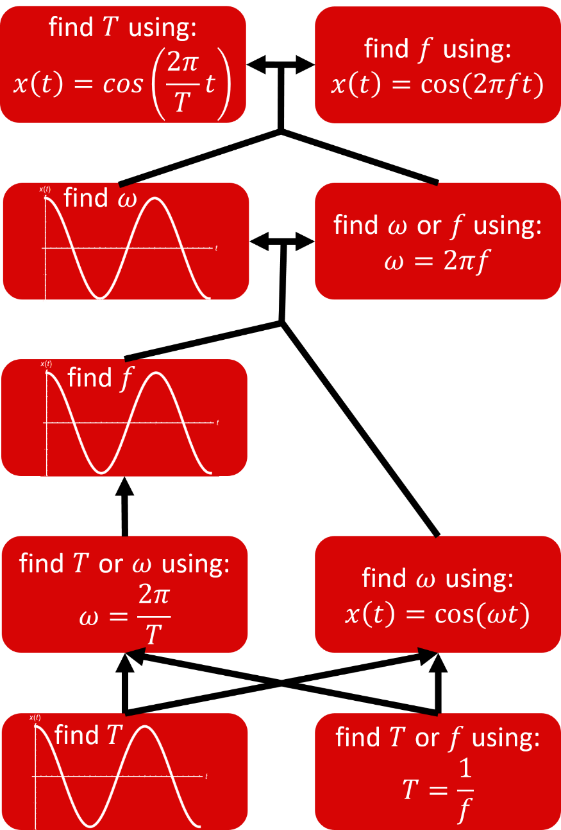
Revised Hierarchy
Figure 2: Hierarchy of skills related to determining the period, frequency, and angular frequency generated from item tree analysis
Notes:
The revised hierarchy has a similar ordering of the skills, but provides a more nuanced structure. The key differences from the preliminary results are that the top and middle levels have become more defined and that finding the frequency from a graphical representation and finding the angular frequency from an equational representation have switched places.

Slide 12
Conclusions
Can be modeled as multi-level hierarchy
T=1/f and finding period are essential
Notes:
The key takeaways are that student understanding of period, frequency, and angular frequency can be modeled as a multi-level hierarchy and finding the period from a graphical representation and using the relation T=1/f are fundamental for understanding any of the other skills.

Slide 13
Funding/Questions
Questions?
A poster will be presented at the 9:15-10 session (E34) on this work.
Funding for this project provided by the Center for Emergent Materials: an NSF MRSEC under award number DMR-1420451.

